Slide 1
Data Exploration, A
Shih Yu Chang

Slide 2
Today:
Data description
Handling data quality

Slide 3
Data quality report, 4
Visualized by:
Histogram
Bar plot

Slide 5
Which are cont.
Which are cat.

Slide 9
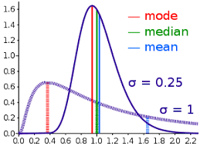
Getting to know your data, 15
Categorical features: mode, 2nd mode, mode %, and 2nd mode %
Continuous features: the mean and standard deviation

Slide 10
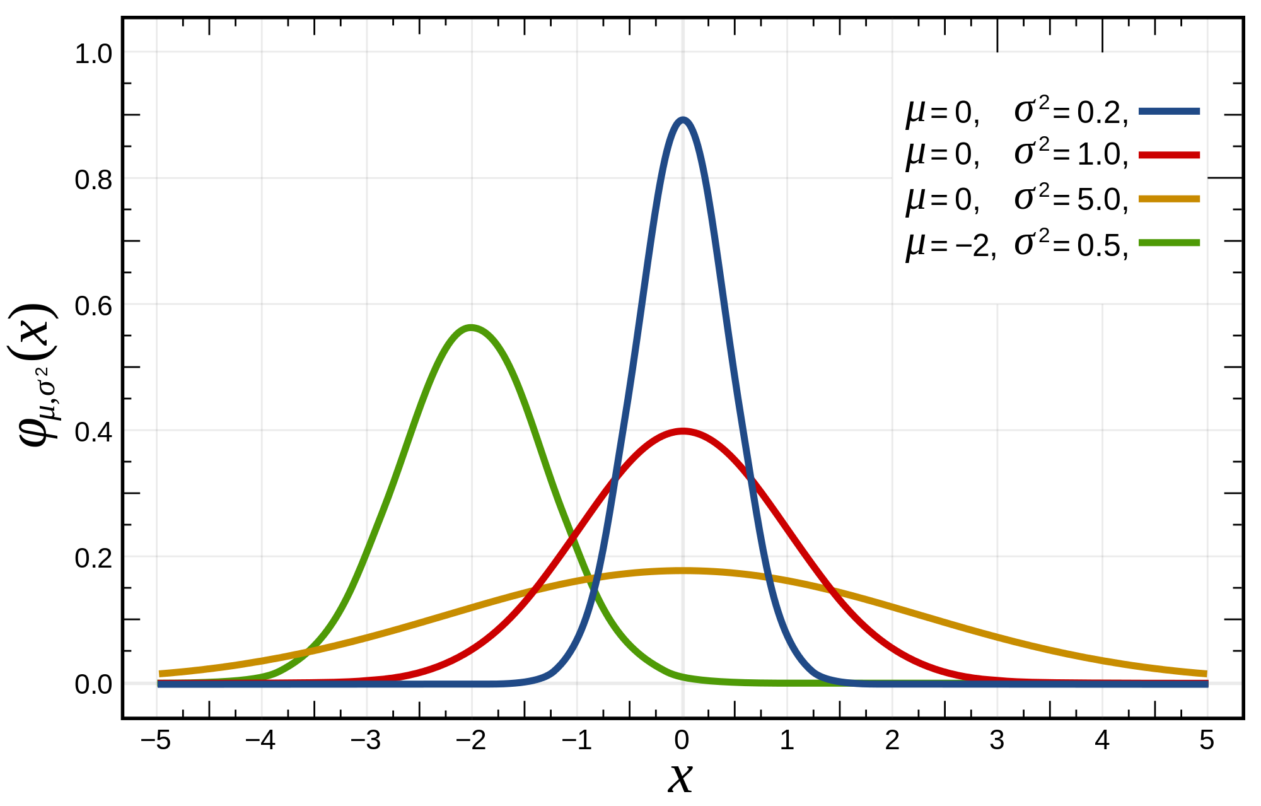
Basic Statistical Descriptions of Data
Motivation
To better understand the data: central tendency, variation and spread
Data dispersion characteristics
Median, max, min, quantiles, outliers, variance, ...
Numerical dimensions correspond to sorted intervals
Data dispersion:
Analyzed with multiple granularities of precision
Boxplot or quantile analysis on sorted intervals
Dispersion analysis on computed measures
Folding measures into numerical dimensions
Boxplot or quantile analysis on the transformed cube
Notes:
Note to self (MK): last part of slide does not clearly match slides that follow
Introduction slides:
In the current version, we only talk about numeric data. Can we add some materials about non-numeric data.
- text statistics, TF/IDF
- visualization of text statistics such as word cloud
- distribution of Internet (IN, SCC, OUT, …)
- visualization of social relationship (e.g., http://renlifang.msra.cn/)

Slide 11
Measuring the Central Tendency: (1) Mean
Mean (algebraic measure) (sample vs. population):
Note: n is sample size and N is population size.
Weighted arithmetic mean:
Trimmed mean:
Chopping extreme values (e.g., Olympics gymnastics score computation)

Slide 12
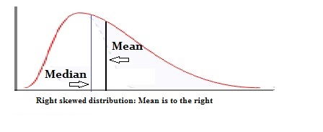
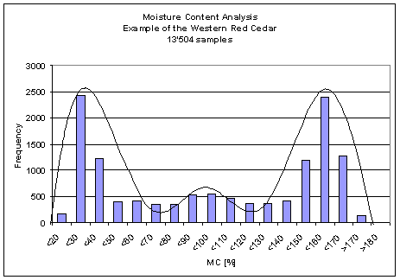
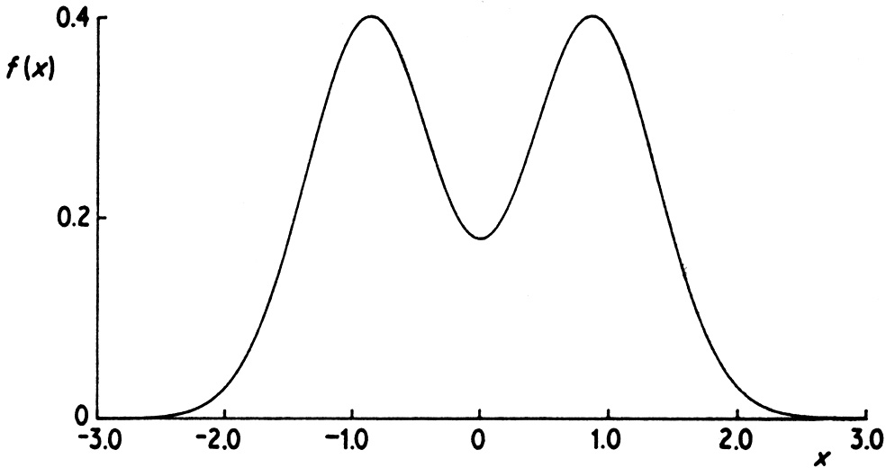
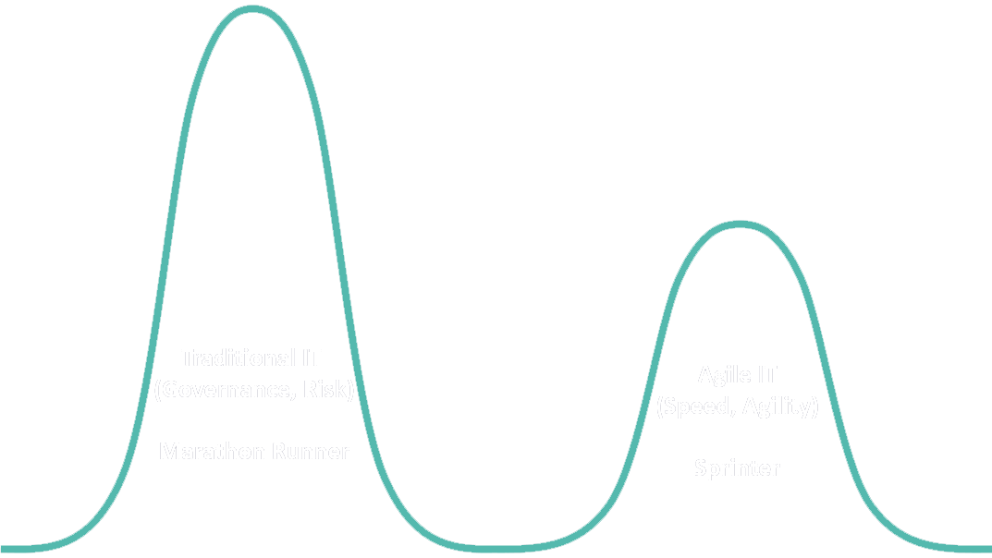
Measuring the Central Tendency: (3) Mode
Mode: Value that occurs most frequently in the data
Unimodal
Empirical formula:
Multi-modal
Bimodal
Trimodal

Slide 13
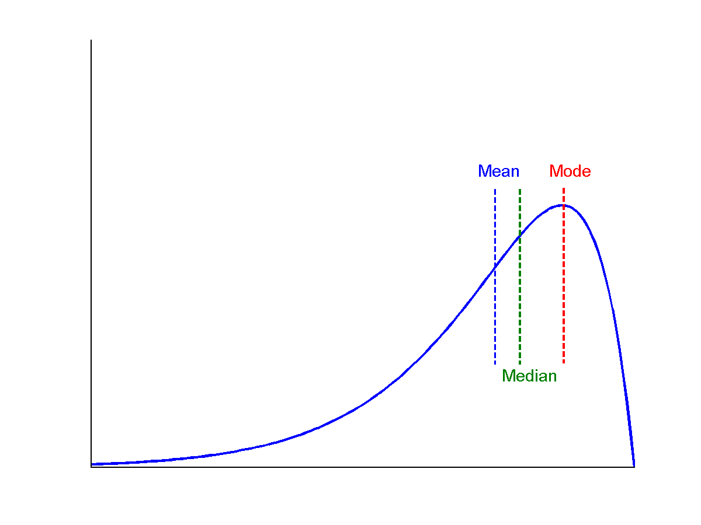
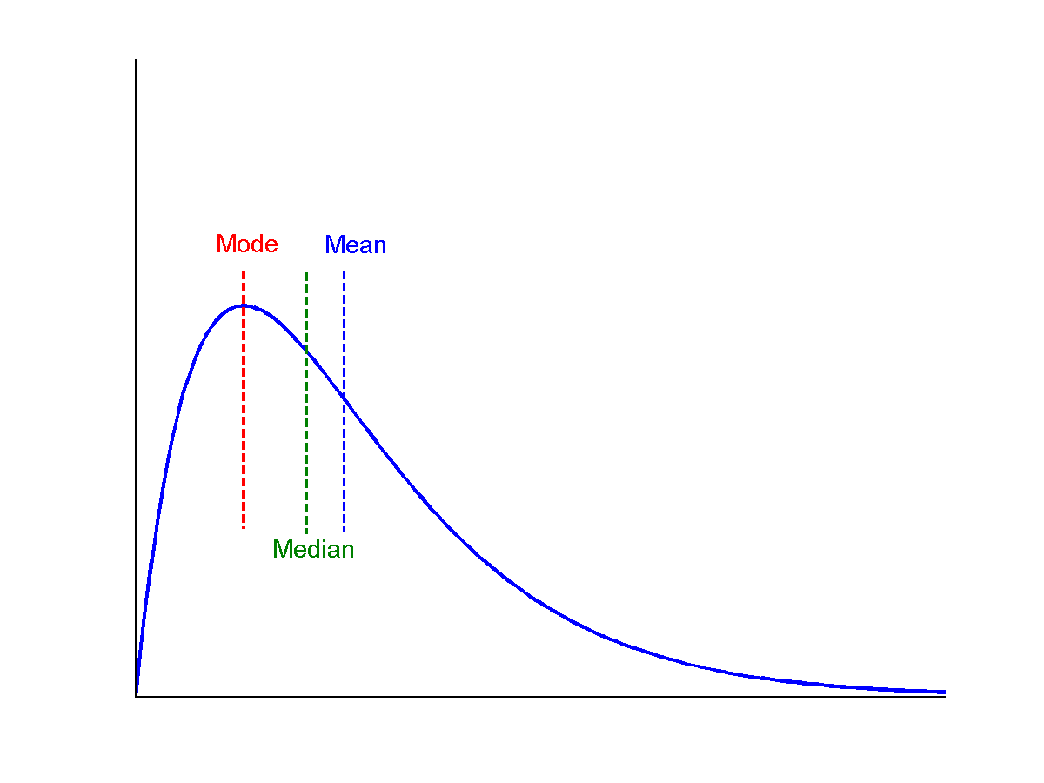
Symmetric vs. Skewed Data
symmetric
Median, mean and mode of symmetric, positively and negatively skewed data
positively skewed
negatively skewed

Slide 14
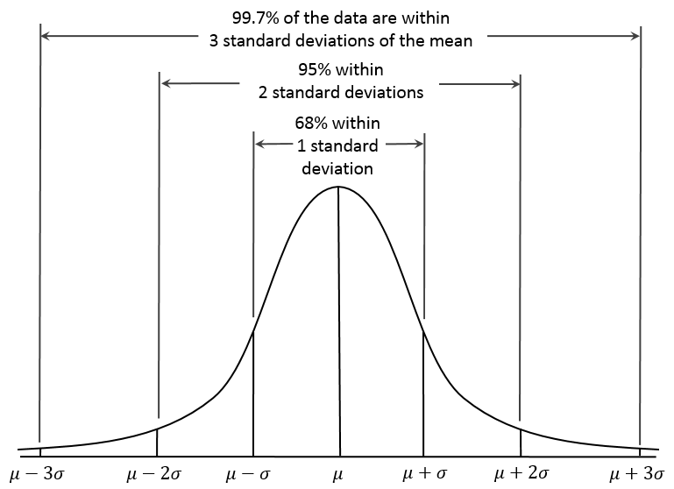
Properties of Normal Distribution Curve
← — ————Represent data dispersion, spread — ————→
Represent central tendency

Slide 15
Measures Data Distribution: Variance and Standard Deviation
Variance and standard deviation (sample: s, population: σ)
Variance: (algebraic, scalable computation)
Q: Can you compute it incrementally and efficiently?
Standard deviation s (or σ) is the square root of variance s² ⁽or σ²⁾

Slide 16
Graphic Displays of Basic Statistical Descriptions
Boxplot: graphic display of five-number summary
Histogram: x-axis are values, y-axis repres. frequencies
Quantile plot: each value x_{i} is paired with f_{i} indicating that approximately 100 f_{i} % of data are ≤ x_{i}
Quantile-quantile (q-q) plot: graphs the quantiles of one univariant distribution against the corresponding quantiles of another
Scatter plot: each pair of values is a pair of coordinates and plotted as points in the plane
Notes:
JH: Maybe we can remove Loess curve

Slide 17
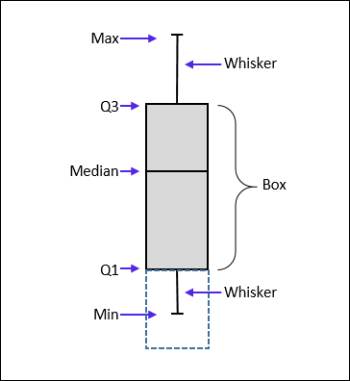
Measuring the Dispersion of Data: Quartiles & Boxplots
Quartiles: Q₁ (25th percentile), Q₃ (75th percentile)
Inter-quartile range: IQR = Q₃ – Q₁
Five number summary: min, Q₁, median, Q₃, max
Boxplot: Data is represented with a box
Q₁, Q₃, IQR: The ends of the box are at the first and third quartiles, i.e., the height of the box is IQR
Median (Q₂) is marked by a line within the box
Whiskers: two lines outside the box extended to Minimum and Maximum
Outliers: points beyond a specified outlier threshold, plotted individually
Outlier: usually, a value higher/lower than 1.5 x IQR

Slide 18
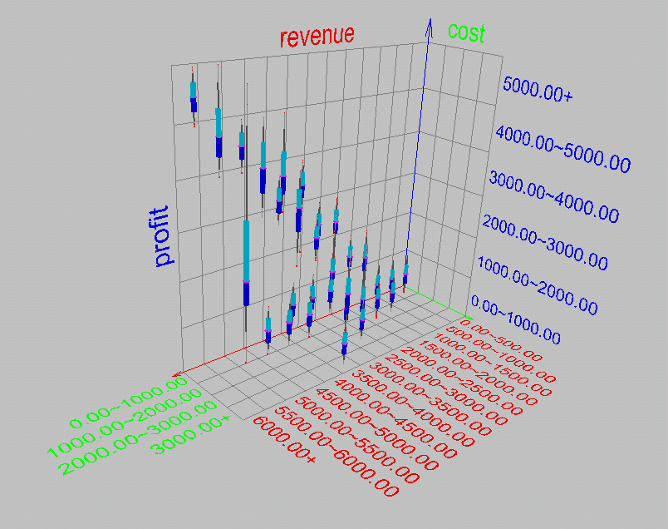
Visualization of Data Dispersion: 3-D Boxplots

Slide 19
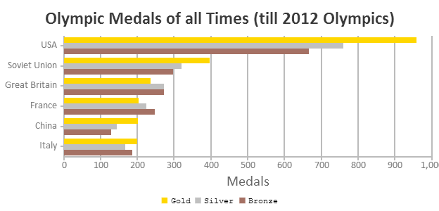
Histogram Analysis
Histogram
Histogram: Graph display of tabulated frequencies, shown as bars
Differences between histograms and bar charts
Histograms are used to show distributions of variables while bar charts are used to compare variables
Histograms plot binned quantitative data while bar charts plot categorical data
Bars can be reordered in bar charts but not in histograms
Differs from a bar chart in that it is the area of the bar that denotes the value, not the height as in bar charts, a crucial distinction when the categories are not of uniform width
Bar chart
Notes:
JH: A better and BASIC histogram figure --- because this one overlaps with a later one!

Slide 20
Histograms Often Tell More than Boxplots
The two histograms shown in the left may have the same boxplot representation
The same values for: min, Q1, median, Q3, max
But they have rather different data distributions

Slide 21
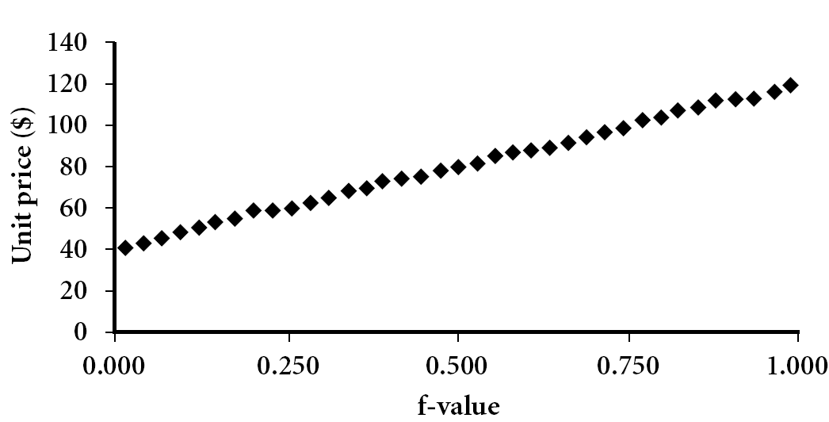
Quantile Plot
Displays all of the data (allowing the user to assess both the overall behavior and unusual occurrences)
Plots quantile information
For a data x_{i} data sorted in increasing order, f_{i} indicates that approximately 100 f_{i}% of the data are below or equal to the value x_{i}

Slide 22
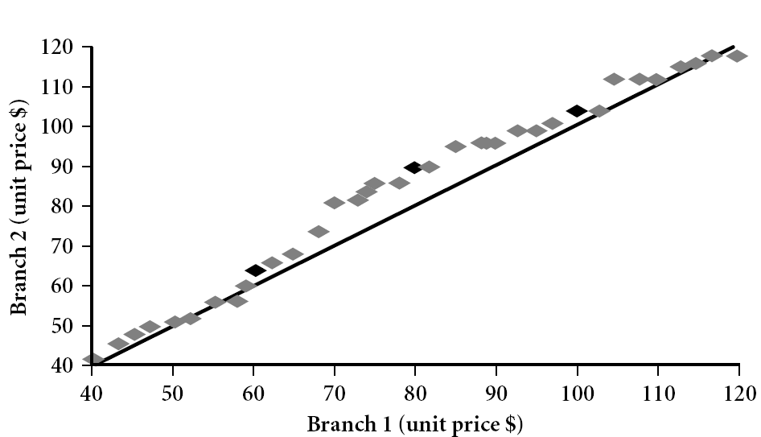
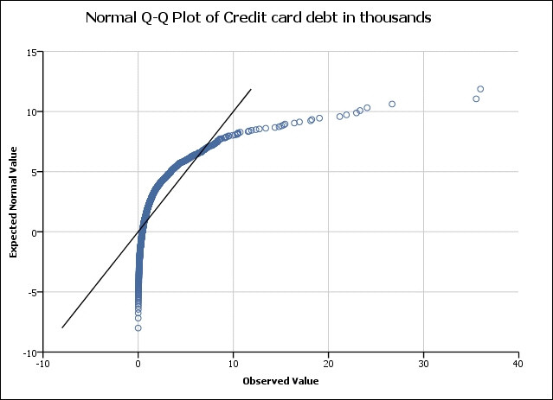
Quantile-Quantile (Q-Q) Plot
Graphs the quantiles of one univariate distribution against the corresponding quantiles of another
View: Is there is a shift in going from one distribution to another?
Example shows unit price of items sold at Branch 1 vs. Branch 2 for each quantile. Unit prices of items sold at Branch 1 tend to be lower than those at Branch 2
https://www.statisticshowto.datasciencecentral.com/q-q-plots/
Notes:
Note: We need to label the dark plotted points as Q1, Median, Q3 – that would help in understanding this graph.
Tell audience: There is a shift in distribution of branch 1 WRT branch 2 in that the unit prices of items sold at branch 1 tend to be lower than those at branch 2.

Slide 30
Gaussian distribution

Slide 33
More about Gaussian distribution, 27,28

Slide 34
Today:
Data description
Handling data quality

Slide 35
Data quality issues
The most common data quality issues are:
missing values
Accuracy: correct or wrong, accurate or not
Completeness: not recorded, unavailable, …
Consistency: some modified but some not, dangling, …
Timeliness: timely update?
Believability: how trustable the data are correct?
Interpretability: how easily the data can be understood?
Noisy (perturbed) data
outliers

Slide 36
Data quality issues, examples
Data in the Real World Is Dirty: Lots of potentially incorrect data, e.g., instrument faulty, human or computer error, and transmission error
Incomplete: lacking attribute values, lacking certain attributes of interest, or containing only aggregate data
e.g., Occupation = “ ” (missing data)
Noisy: containing noise, errors, or outliers
e.g., Salary = “−10” (an error)
Inconsistent: containing discrepancies in codes or names, e.g.,
Age = “42”, Birthday = “03/07/2010”
Was rating “1, 2, 3”, now rating “A, B, C”
discrepancy between duplicate records
Intentional (e.g., disguised missing data)
Cheating medical products/services

Slide 37
Incomplete (Missing) Data
Data is not always available
E.g., many tuples have no recorded value for several attributes, such as customer income in sales data
Missing data may be due to
Equipment malfunction
Inconsistent with other recorded data and thus deleted
Data were not entered due to misunderstanding
Certain data may not be considered important at the time of entry
Did not register history or changes of the data
Missing data may need to be inferred

Slide 38
How to Handle Missing Data?
Imputation replaces missing feature values with a plausible estimated value based on the feature values that are present.
The most common approach to imputation is to replace missing values for a feature with a measure of the central tendency of that feature.
In general, we would be reluctant to use imputation on features missing in excess of 30% of their values and would strongly recommend against the use of imputation on features missing in excess of 50% of their values.

Slide 39
Noisy Data
Noise: random error or variance in a measured variable
Incorrect attribute values may be due to
Faulty data collection instruments
Data entry problems
Data transmission problems
Technology limitation
Inconsistency in naming convention
Other data problems
Duplicate records
Incomplete data
Inconsistent data
Notes:
39

Slide 40
How to Handle Noisy Data?
Binning
First sort data and partition into (equal-frequency) bins
Then one can smooth by bin means, smooth by bin median, smooth by bin boundaries, etc.
Regression
Smooth by fitting the data into regression functions
Clustering
Detect and remove outliers
Semi-supervised: Combined computer and human inspection
Detect suspicious values and check by human (e.g., deal with possible outliers)
Notes:
Enrich using data integration research!!

Slide 41
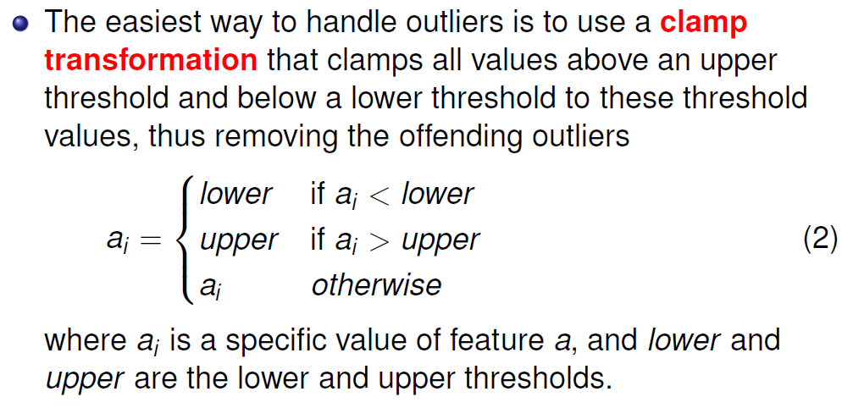
Handling outliers

Slide 42
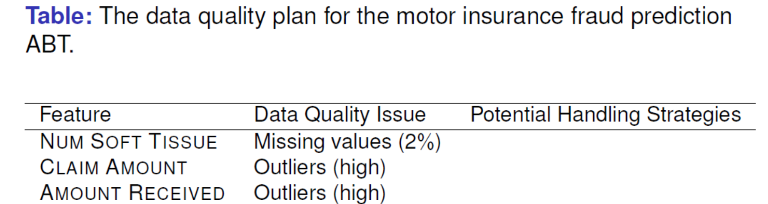
Discussions
What handling strategies would you recommend for the data quality issues found in the motor Insurance fraud ABT?

Slide 43
Discussions: Data Exploration with true data
Based on my demo code and NBA data try to do following:
What problems are there at current data?
How you fix them and why?
Can you visualize the data and provide insight explanations?

Slide 44
Summary
Understand your data, especially their central tendencies, variations, and distributions.
Data quality issues: particular missing values, noisy data, and outliers.

Slide 45
Supplement: Data Types

Slide 46
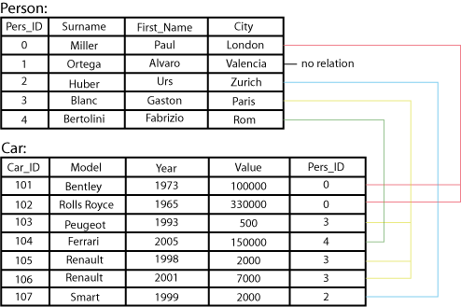
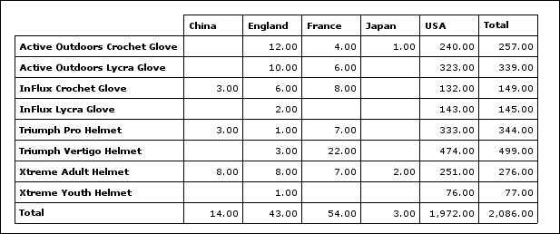
Types of Data Sets: (1) Record Data
Relational records
Relational tables, highly structured
Data matrix, e.g., numerical matrix, crosstabs
Transaction data
Document data: Term-frequency vector (matrix) of text documents

Slide 47
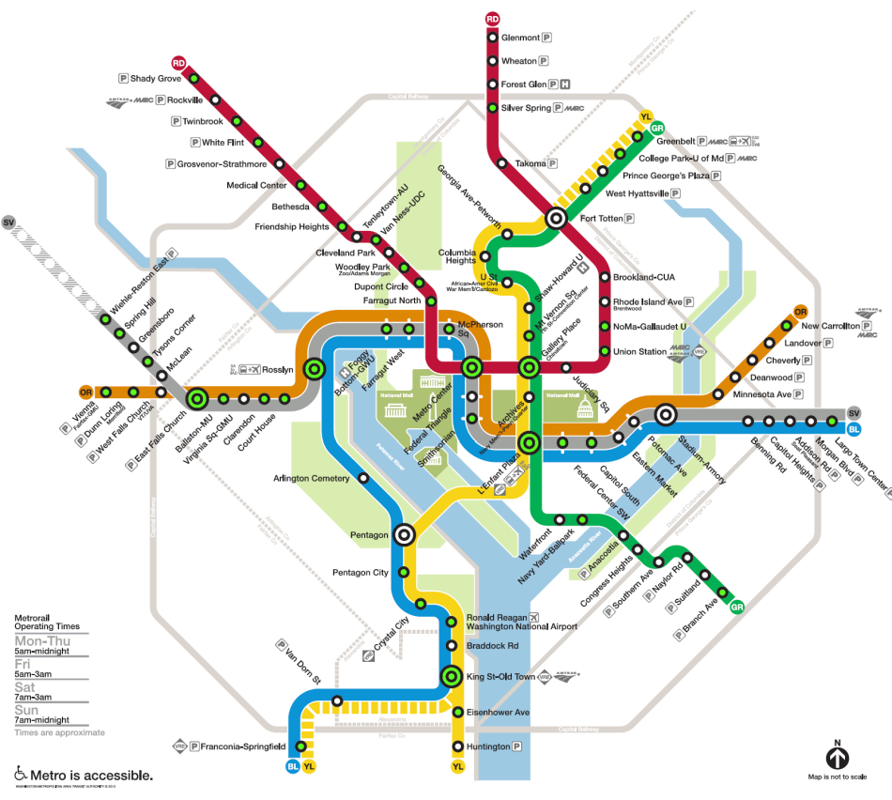

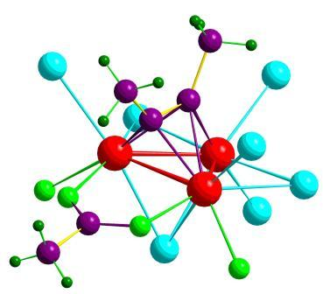

Types of Data Sets: (2) Graphs and Networks
Transportation network
World Wide Web
Molecular Structures
Social or information networks

Slide 48
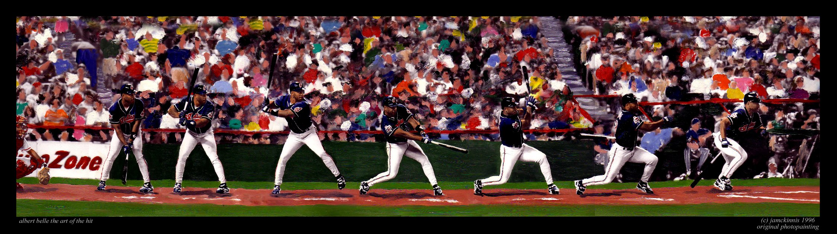
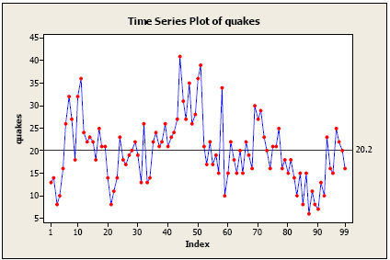
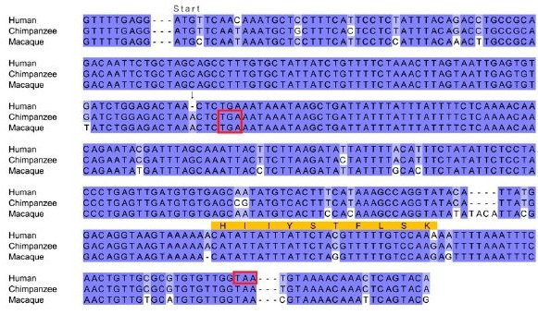
Types of Data Sets: (3) Ordered Data
Video data: sequence of images
Temporal data: time-series
Sequential Data: transaction sequences
Genetic sequence data

Slide 49
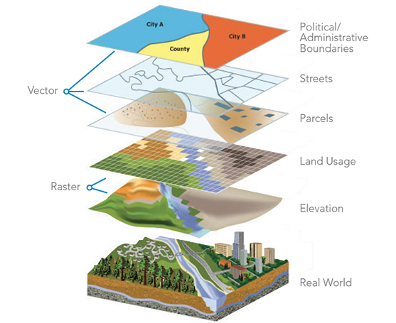
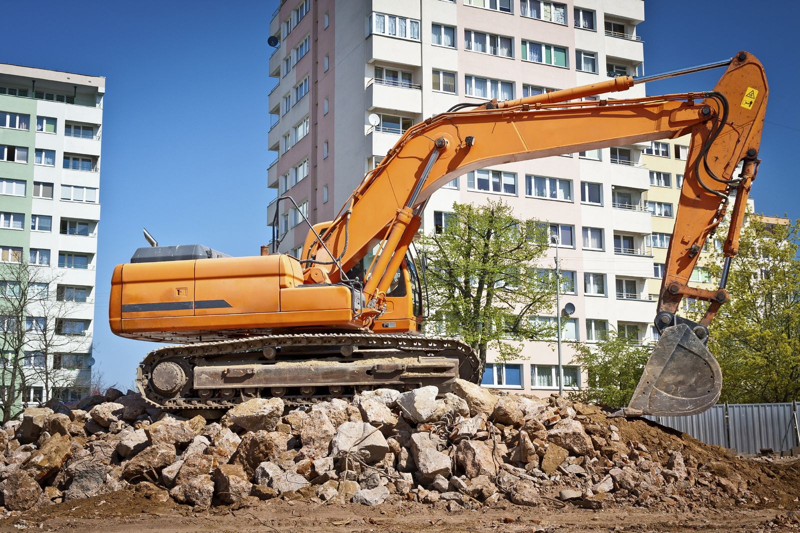
Types of Data Sets: (4) Spatial, image and multimedia Data
Spatial data: maps
Image data:
Video data:

Slide 50
Important Characteristics of Structured Data
Dimensionality
Curse of dimensionality
Sparsity
Only presence counts
Resolution
Patterns depend on the scale
Distribution
Centrality and dispersion

Slide 51
Data Objects
Data sets are made up of data objects
A data object represents an entity
Examples:
sales database: customers, store items, sales
medical database: patients, treatments
university database: students, professors, courses
Also called samples , examples, instances, data points, objects, tuples
Data objects are described by attributes
Database rows → data objects; columns → attributes

Slide 52
Attributes
Attribute (or dimensions, features, variables)
A data field, representing a characteristic or feature of a data object.
E.g., customer _ID, name, address
Types:
Nominal (e.g., red, blue)
Binary (e.g., {true, false})
Ordinal (e.g., {freshman, sophomore, junior, senior})
Numeric: quantitative
Interval-scaled: 100○C is interval scales
Ratio-scaled: 100○K is ratio scaled since it is twice as high as 50 ○K
Q1: Is student ID a nominal, ordinal, or interval-scaled data?
Q2: What about eye color? Or color in the color spectrum of physics?

Slide 53
Attribute Types
Nominal: categories, states, or “names of things”
Hair_color = {auburn, black, blond, brown, grey, red, white}
marital status, occupation, ID numbers, zip codes
Binary
Nominal attribute with only 2 states (0 and 1)
Symmetric binary: both outcomes equally important
e.g., gender
Asymmetric binary: outcomes not equally important.
e.g., medical test (positive vs. negative)
Convention: assign 1 to most important outcome (e.g., HIV positive)
Ordinal
Values have a meaningful order (ranking) but magnitude between successive values is not known
Size = {small, medium, large}, grades, army rankings

Slide 54
Numeric Attribute Types
Quantity (integer or real-valued)
Interval
Measured on a scale of equal-sized units
Values have order
E.g., temperature in C˚or F˚, calendar dates
No true zero-point
Ratio
Inherent zero-point
We can speak of values as being an order of magnitude larger than the unit of measurement (10 K˚ is twice as high as 5 K˚).
e.g., temperature in Kelvin, length, counts, monetary quantities

Slide 55
Discrete vs. Continuous Attributes
Discrete Attribute
Has only a finite or countably infinite set of values
E.g., zip codes, profession, or the set of words in a collection of documents
Sometimes, represented as integer variables
Note: Binary attributes are a special case of discrete attributes
Continuous Attribute
Has real numbers as attribute values
E.g., temperature, height, or weight
Practically, real values can only be measured and represented using a finite number of digits
Continuous attributes are typically represented as floating-point variables

Slide 56
Supplement:

